Slide 1
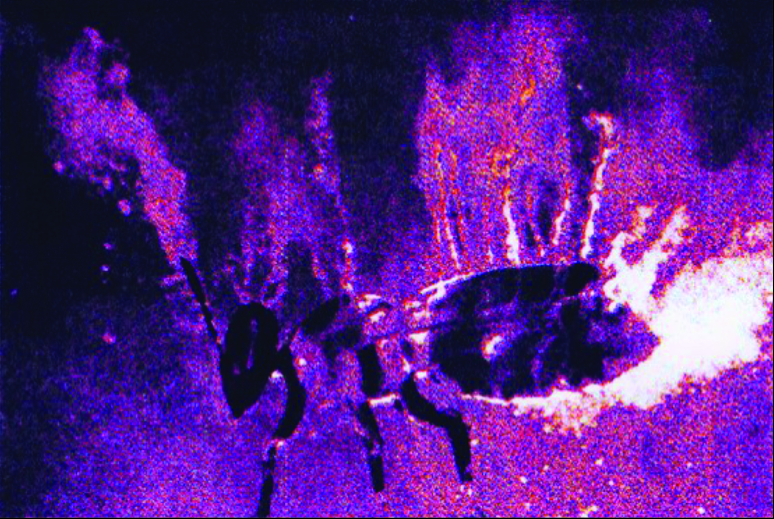
Reception & learning of electric fields in bees
The fact that insects carry an electric charge is well known.
But what is its relevance for the animal?
U. Warnke 1968
C_{s}-Aerosol flux of a charged bee
Notes:
,

Slide 2
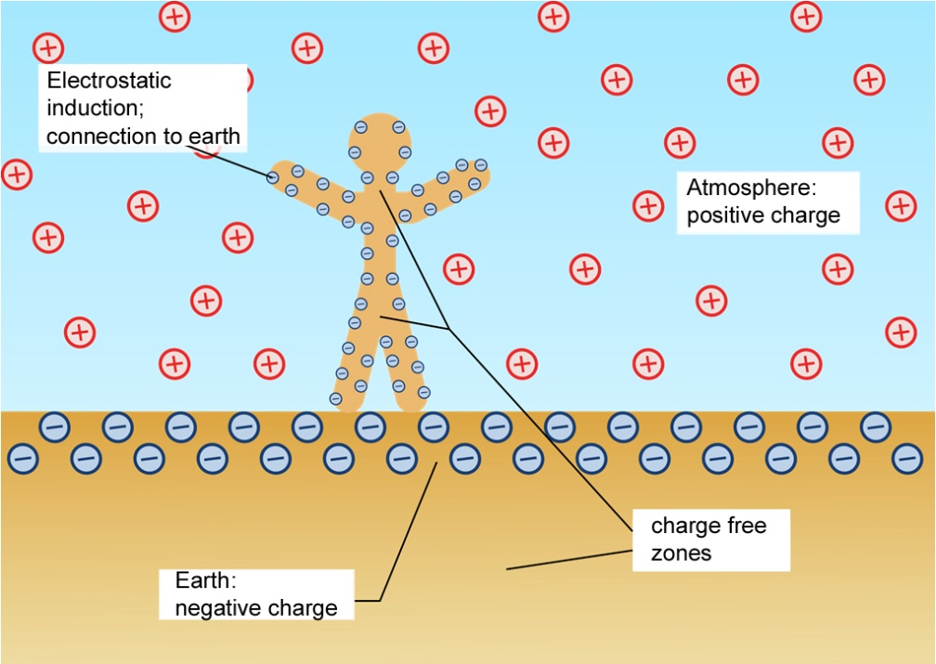
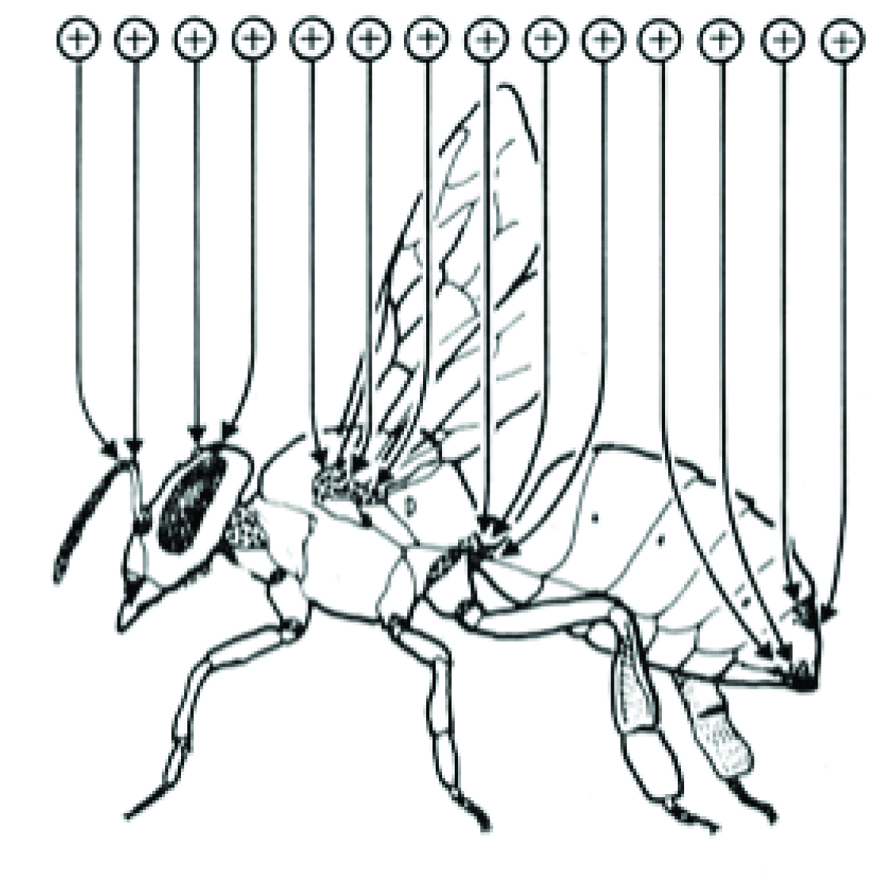
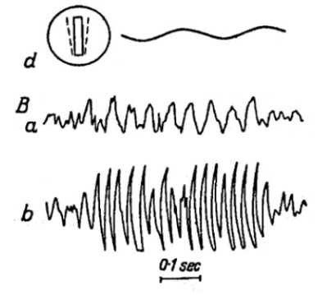
Charge by air friction
Highly insulated insects charge
their cuticula during flight.
U. Warnke 1973
ESF signal of a dummy wing
Yeskov 1967

Slide 3
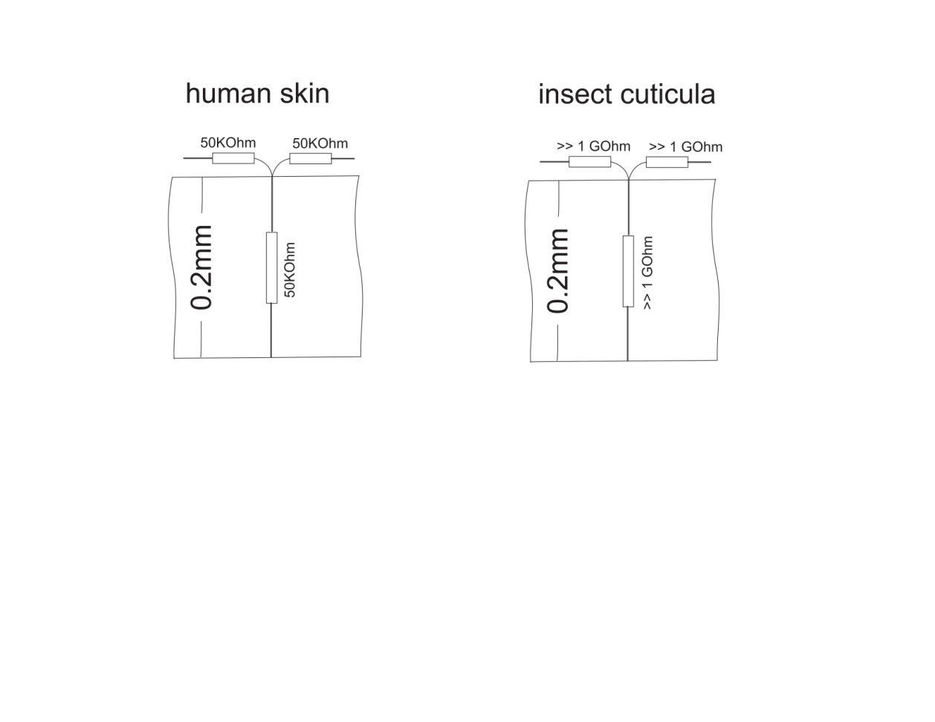
Conductivity of human skin and the exoskeleton of insects
There is no relevant current flow on the surface of insects as proposed by previous authors!

Slide 4
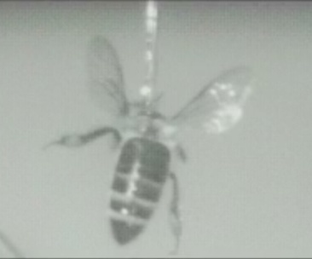
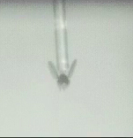
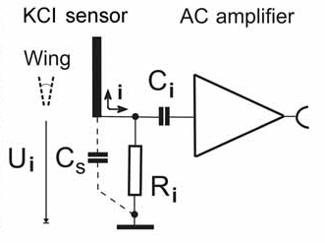
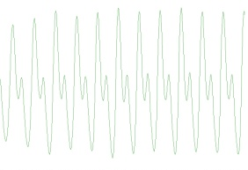
The electrically charged wing
The charged wing as the fast-moving body part emanates an alternating electric field. The dynamics of this field can be recorded by a remote electrode connected to an AC amplifier or displayed as the mechanical movement of the receiving flagellum.
Bee with four wings !
Output voltage
Drosophila
Björn Brembs
To measure a DC-potential remotely, a chopper device is needed. For insects, this is provided by the wing.

Slide 5
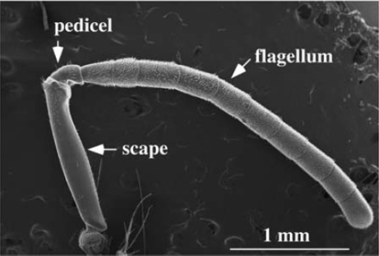
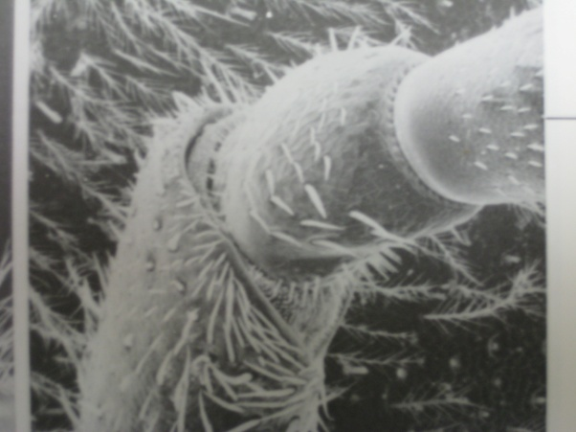
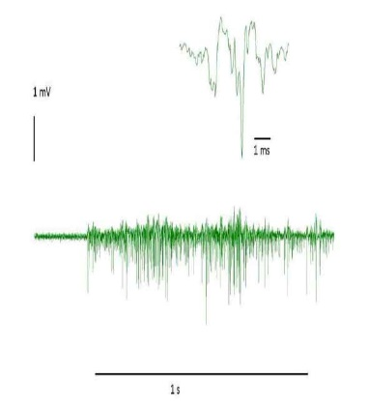
The bee’s ear
Flagellum with Johnston’s organ (multiple mechanoreceptors)
Tsujiuchi, S., Sivan-Loukianova, E., Eberl, D. F., Kitagawa, Y., and Kadowaki, T. 2007
For communication you need a sensitive receiver as well

Slide 6
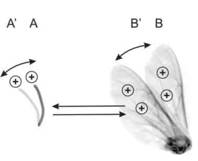
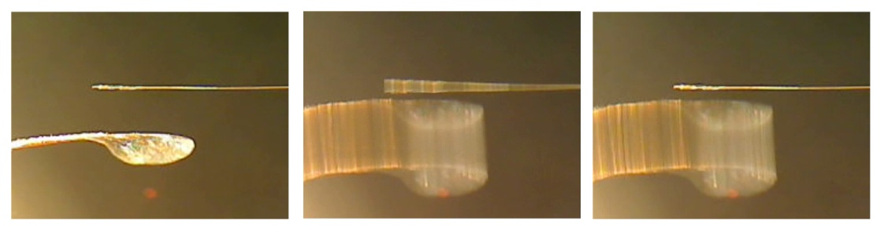

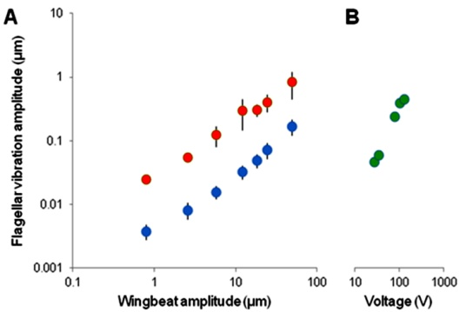
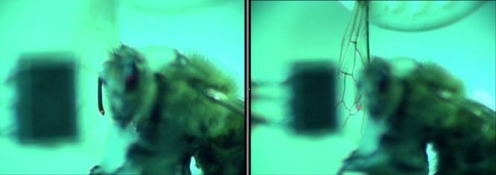
Response of the flagellum to the wing beat
Coulomb forces of wing and flagellum
F
Acoustic versus electric forces
Do honeybees have hearing?
Laser Doppler vibrometry
Threshold of hearing is less than 10nm of flagellar vibration
Vibration amplitude of the antennal flagellum as a function of the oscillation amplitude of an isolated wing placed at a distance of 2 mm from the bee’s head. (Red charged wing, blue acoustic coupling.)
Coulomb forces are easily more the 10 times stronger than acoustic forces especially for frequencies less the 50 Hz

Slide 7
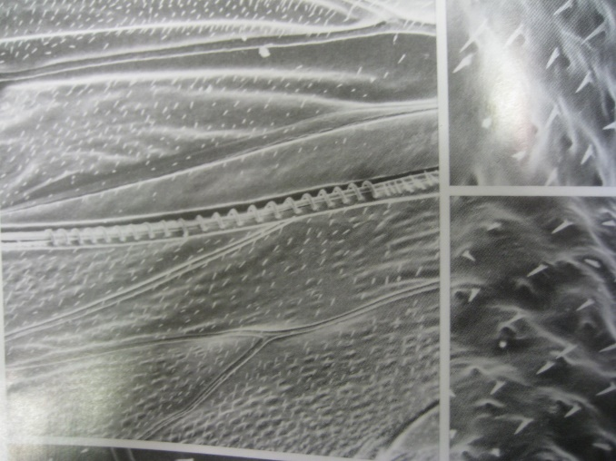
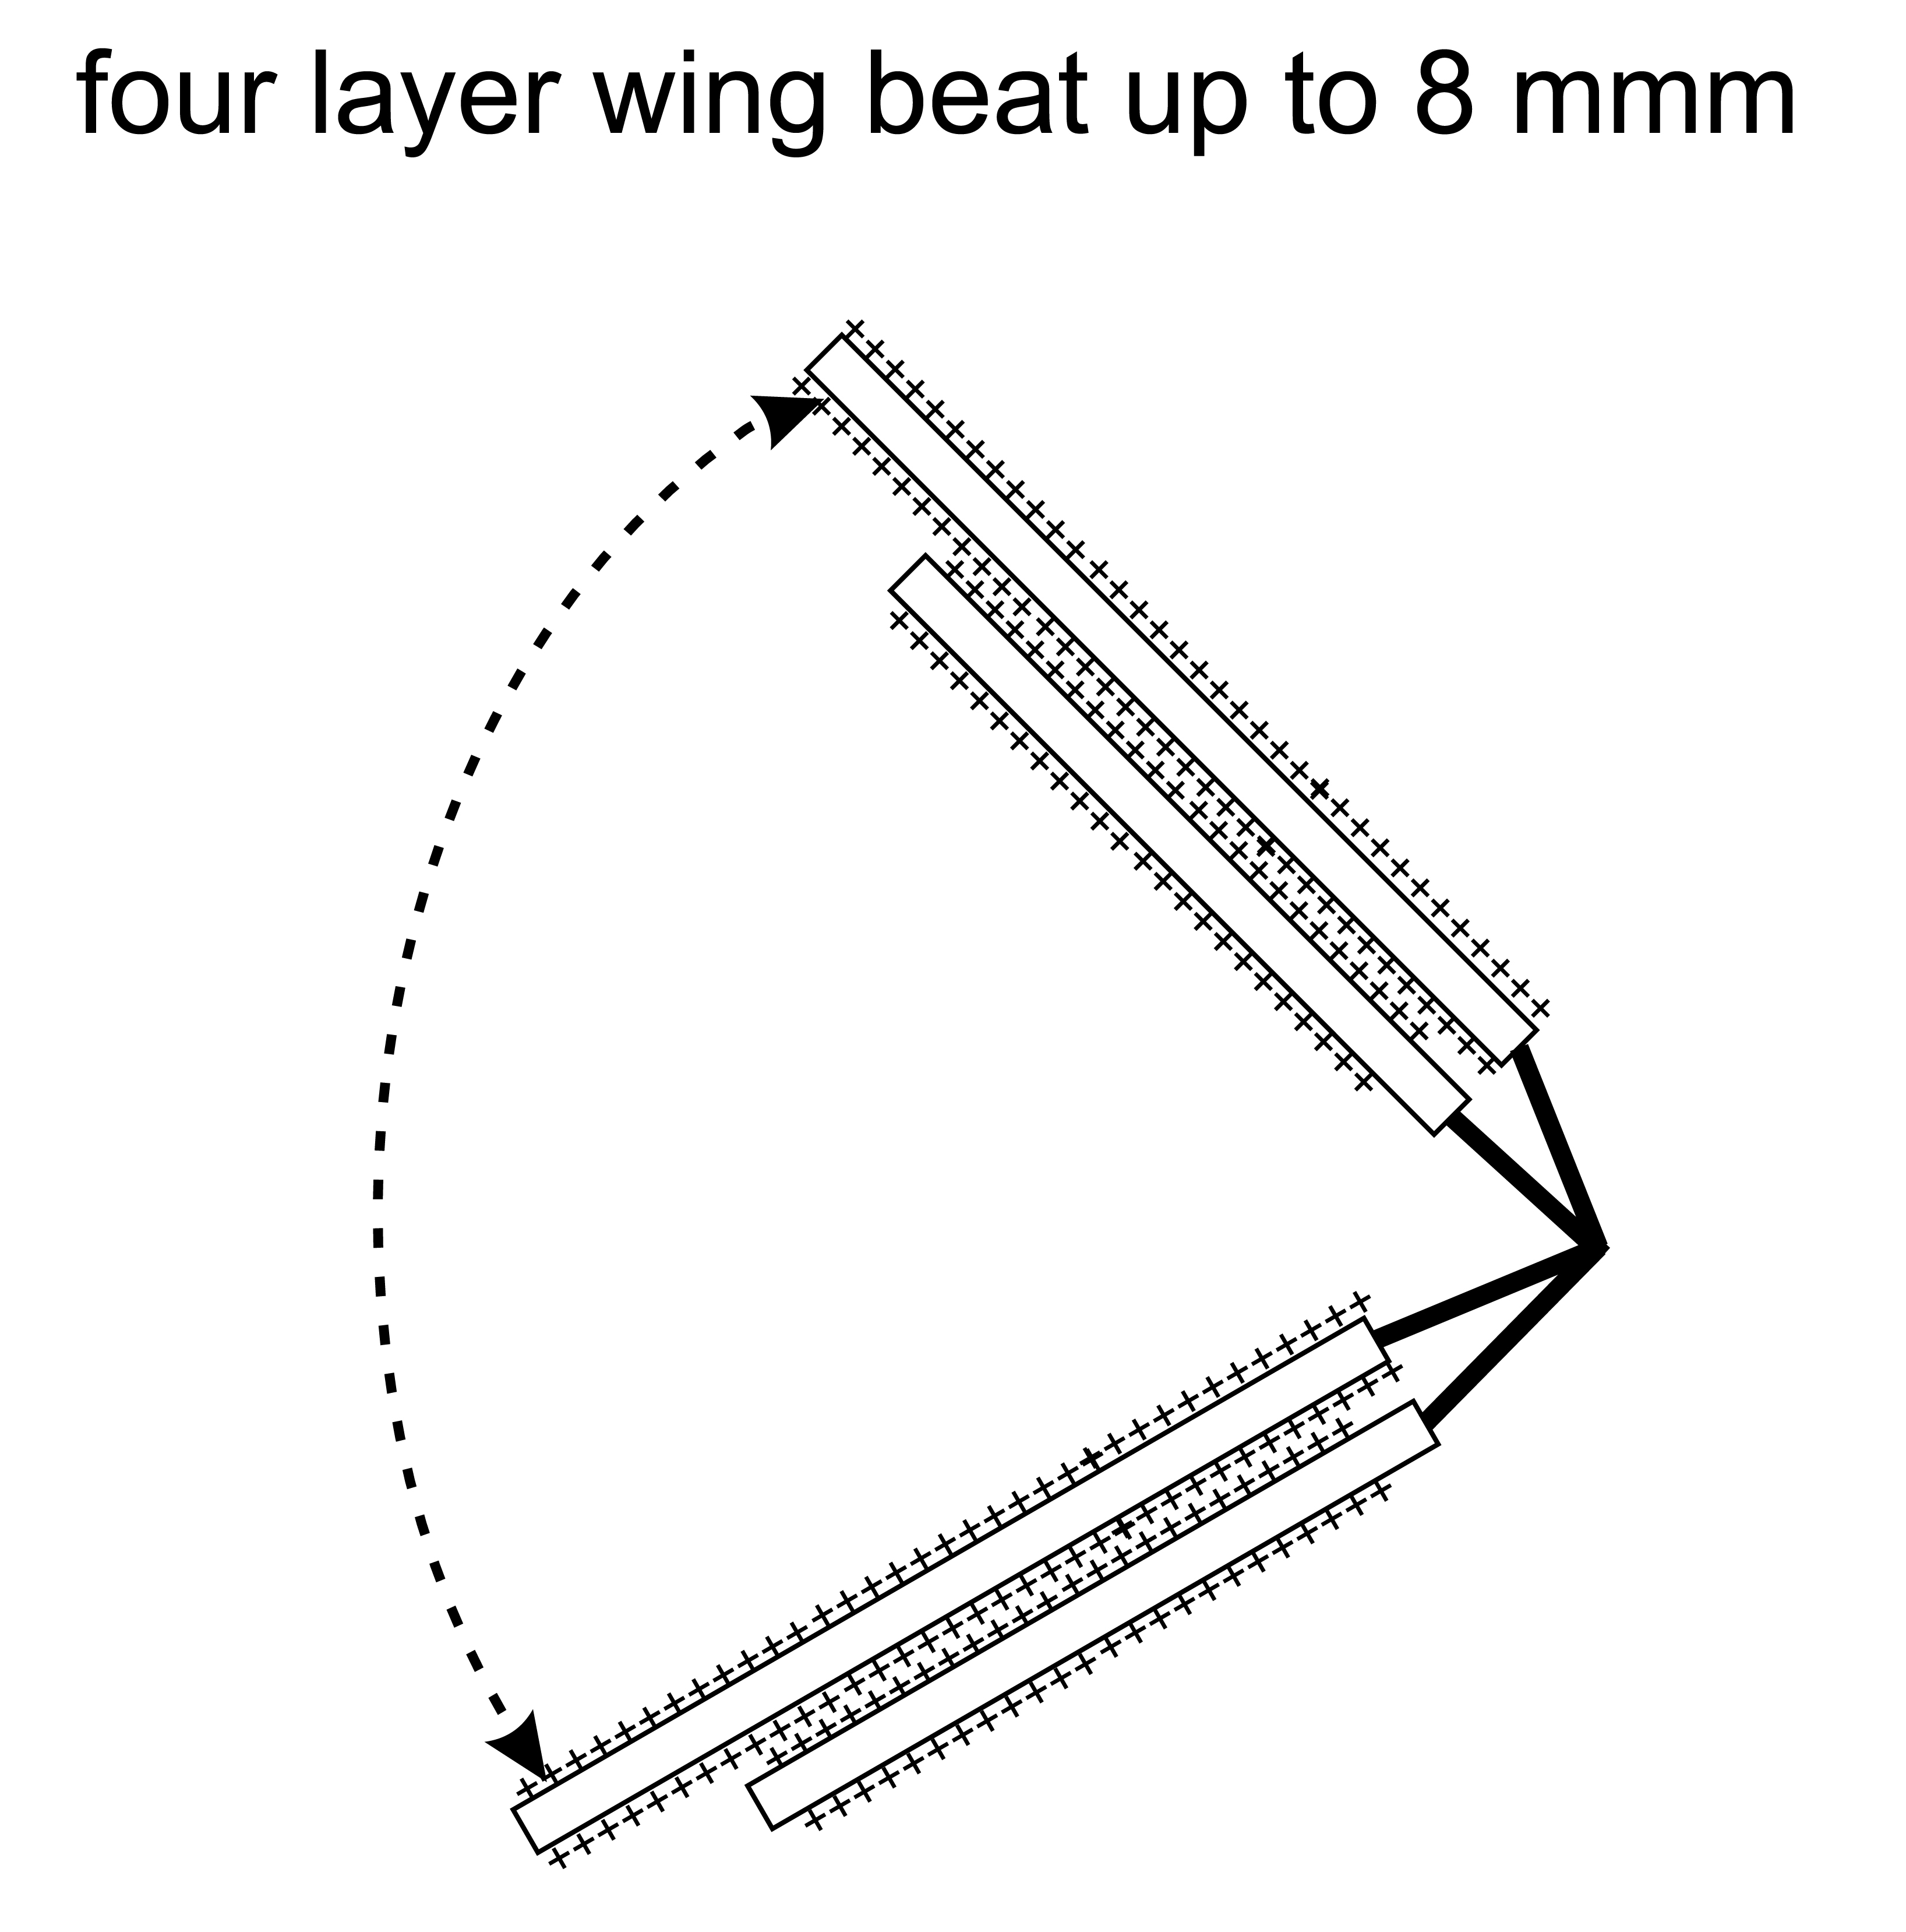
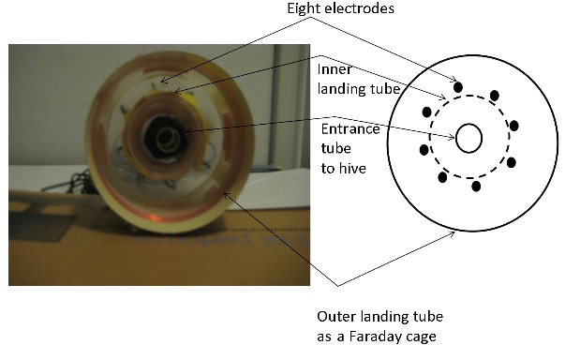
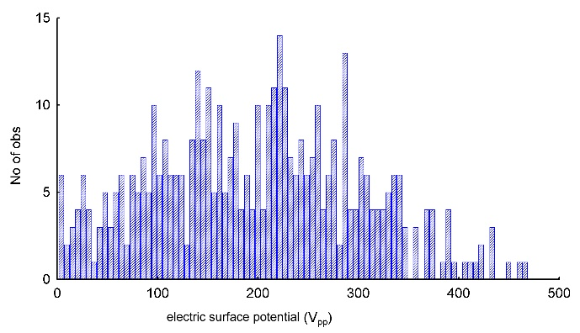
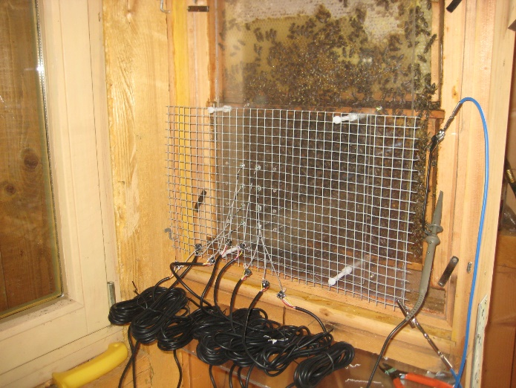
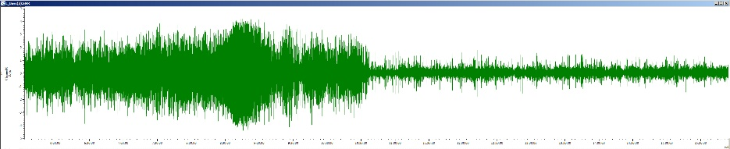
During landing flights with four wings
27°, 45%
rel. Humidity
Effective voltage of a four-layer wing
The natural humidity influences the electric signal on the comb
sunshine in the morning rain in the afternoon
30% rel. Humidity
60% rel. Humidity
Time course of day

Slide 8
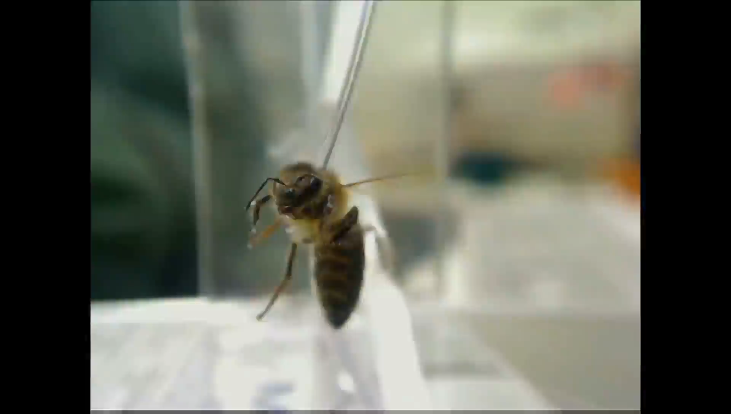
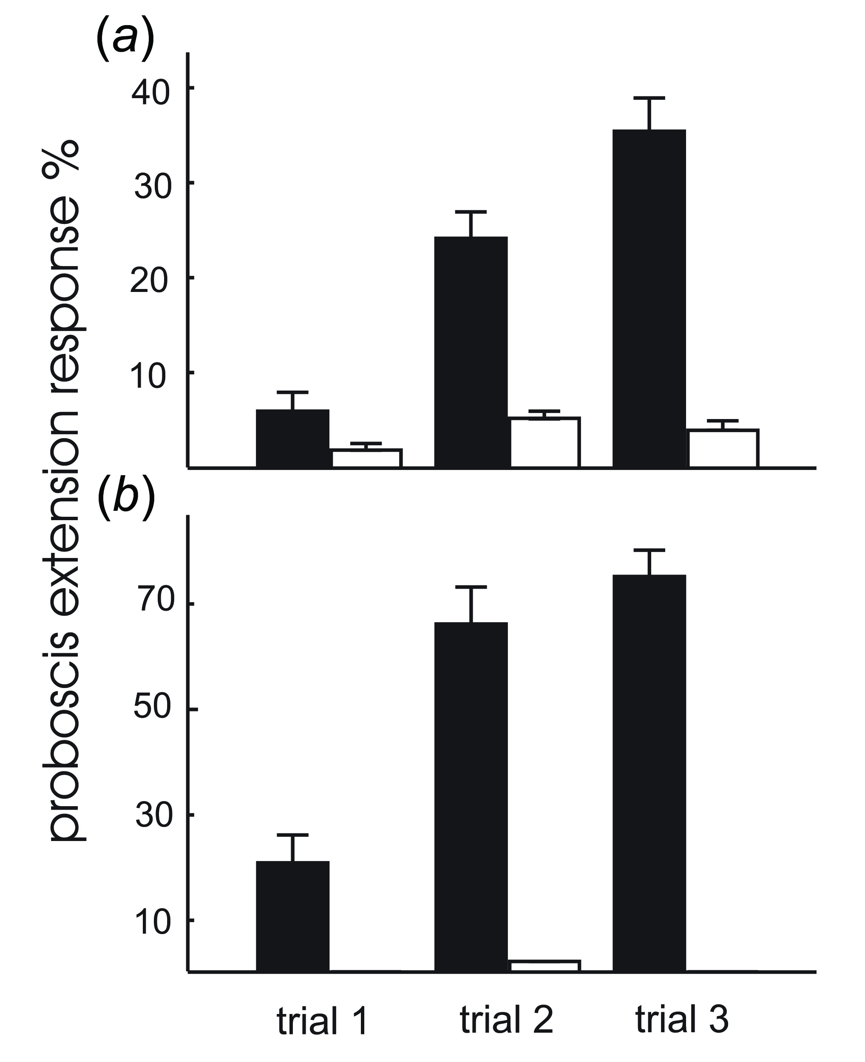
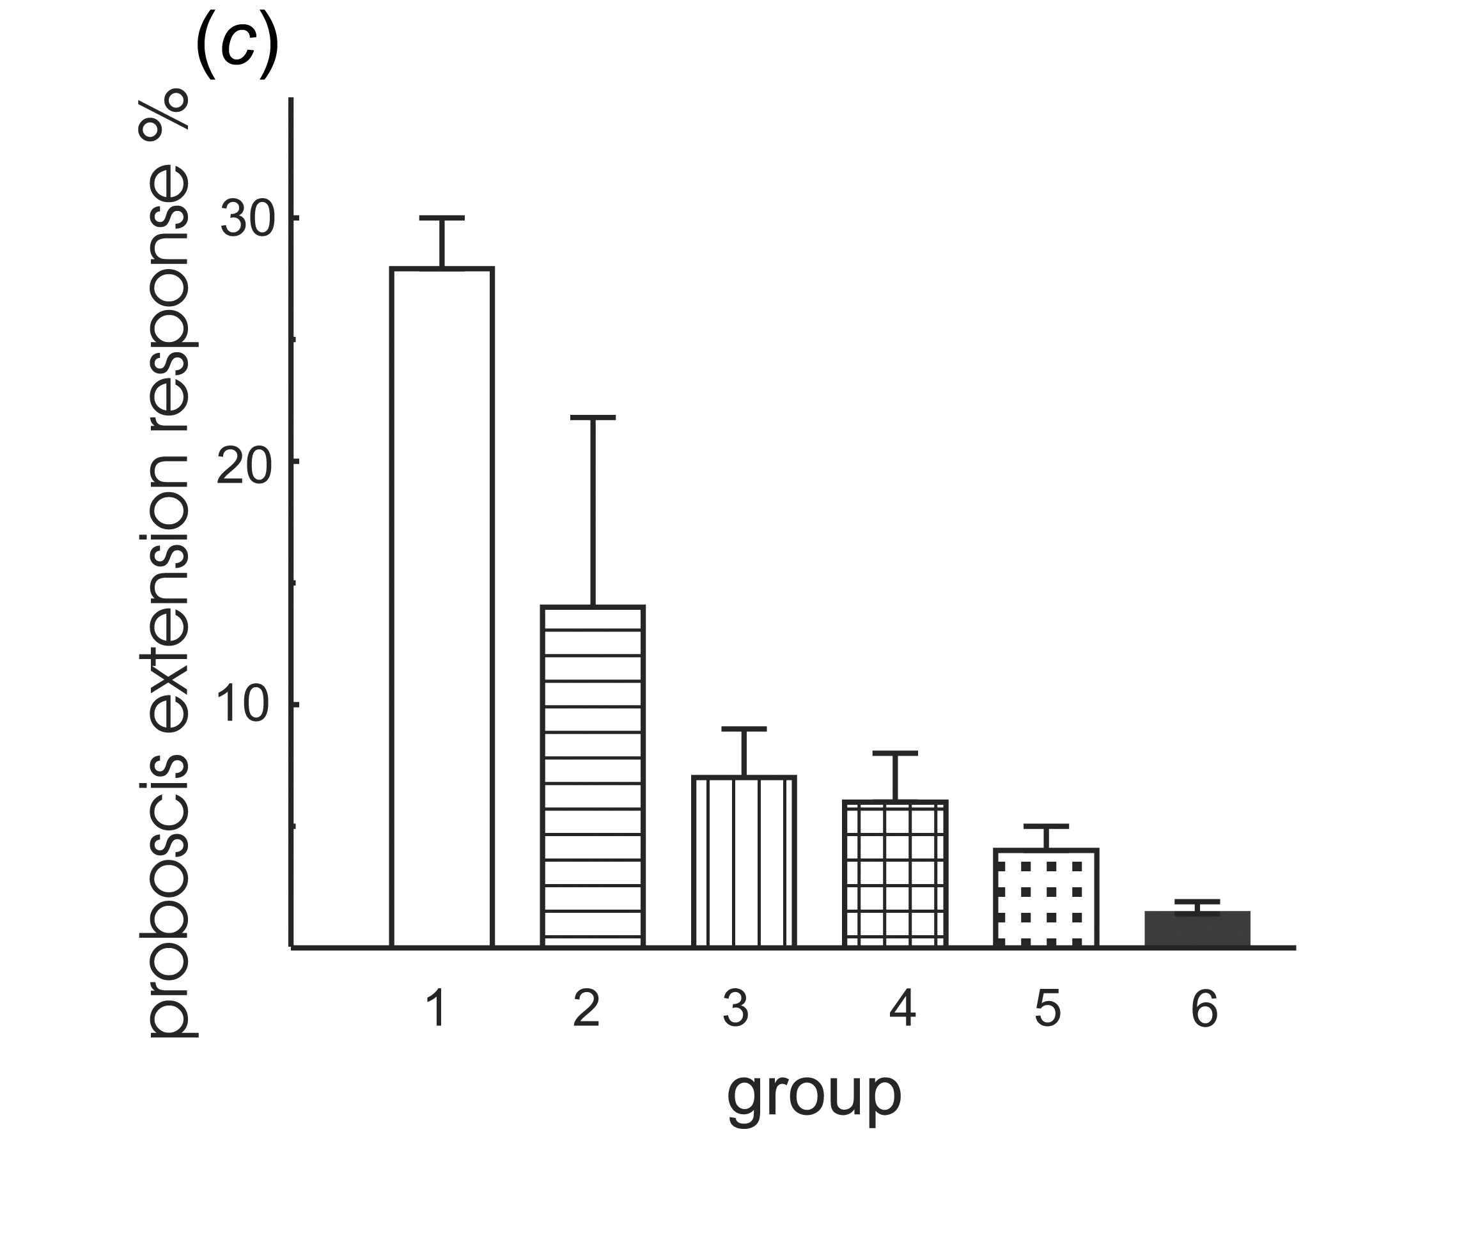
But what is its relevance for the animal?
Differential conditioning of PER (Gesche Koch)
CS+: charged Styrofoam
CS-: uncharged Styrofoam (not shown)
black CS+
white CS-
Styrofoam stimulation
Any kind of manipulation of the antenna reduces learning ability
Antenna free
All response values to the CS + are significantly different to those to
CS- (between groups: d.f. = 1, d.f.error = 96, F = 133.67, p , 0.01
ANOVA repeated measures, between stimuli: d.f. = 2, d.f.error = 192,
F = 7.713, p , 0.02 ANOVA repeated measures).
(c) The effect of manipulation
of the antennae on the CR to a constant electric field as provided by
charged Styrofoam. Group 1: no preparation of the antennae (control group).
Group 2: the flagellae were coated with wax. Group 3: the scapus was fixed
to the head. Group 4: the antennae were fully covered with wax, but joints
between flagellum and pedicel (JO) were free of wax. Group 5: antennae
were fully covered with wax. Group 6: antennae were removed. Group 1 is
significantly different from all other groups: d.f. = 5, d.f.error = 101,
F =74.5, p , 0.01 ANOVA repeated measures).
black CS+
white CS-
AC-stimulation
100Vpp, 60Hz
The response values for all three trials to the CS+ are significantly different to those to CS- (between groups: d.f. = 1, d.f.error = 52, F = 33.67, p , 0.01 ANOVA repeated measures, between stimuli: d.f. = 2, d.f.error = 104, F = 5.143, p , 0.001 ANOVA repeated measures).

Slide 9
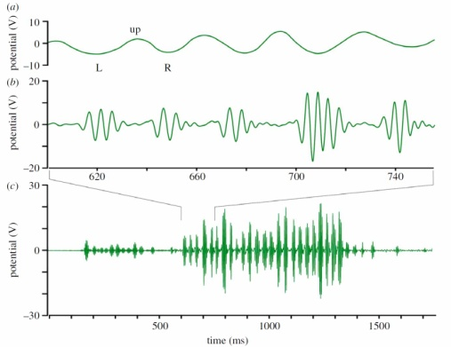
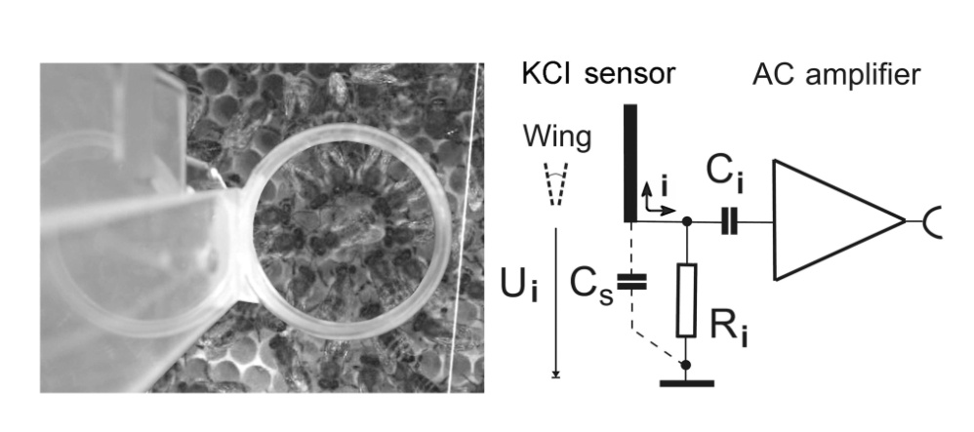
Electric signals in dance communication
abdomen waggle 16-19 Hz
Dancer surrounded by followers
whirring wings 230 Hz
230 Hz
- waggle phase -
24 whirring pulses coding a distance of 720 m

Slide 10
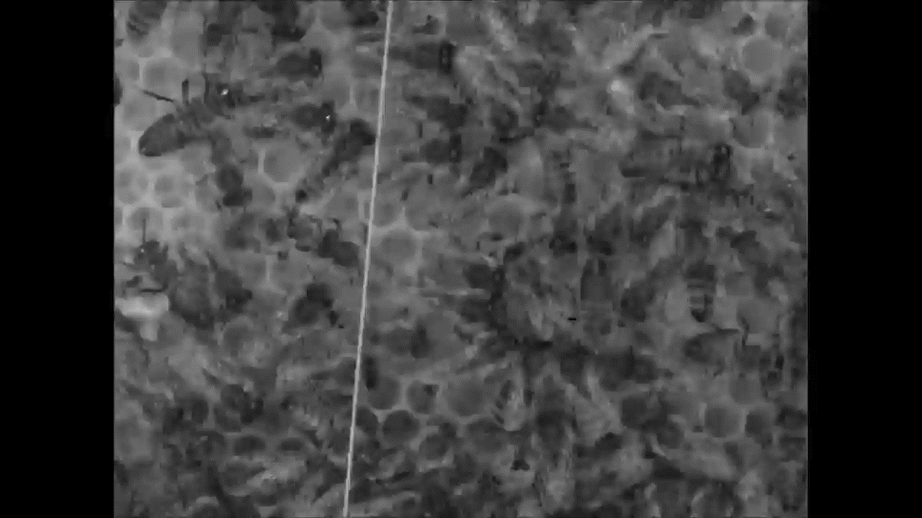
Circular formation during the waggle dance

Slide 11
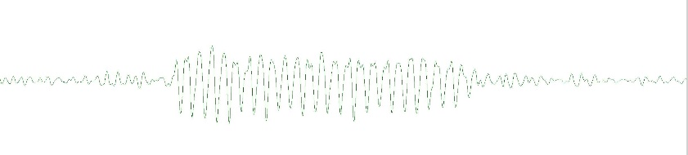
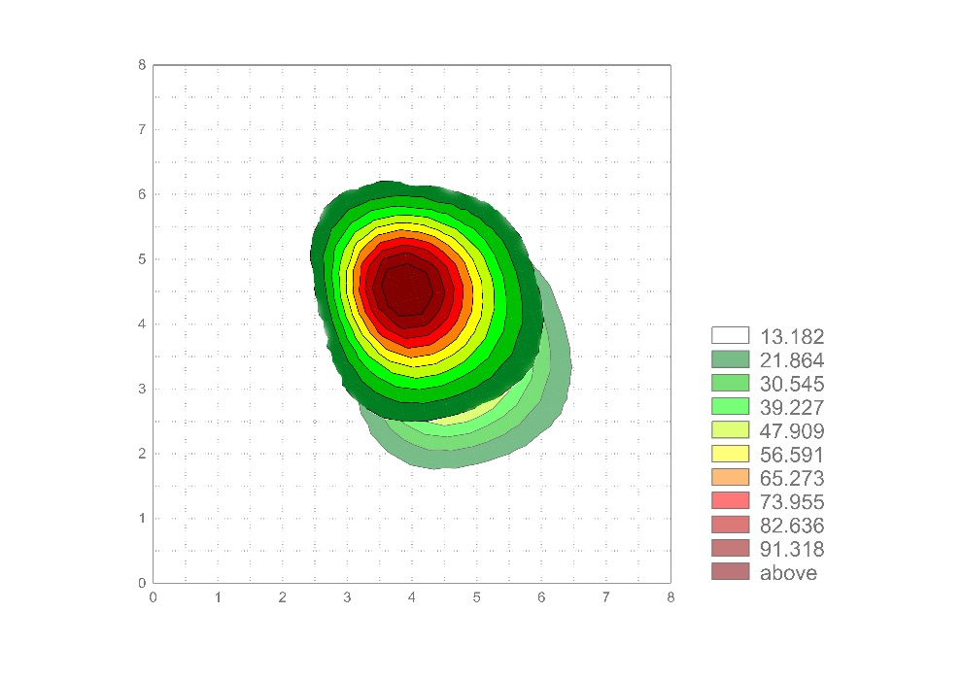
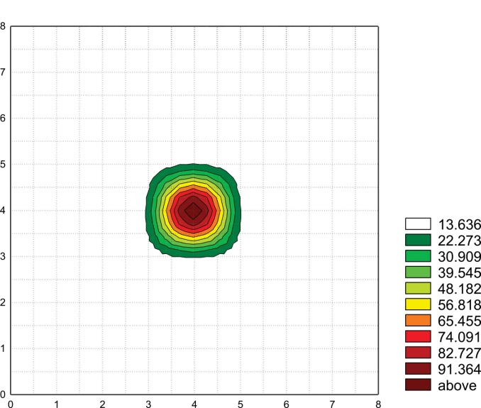
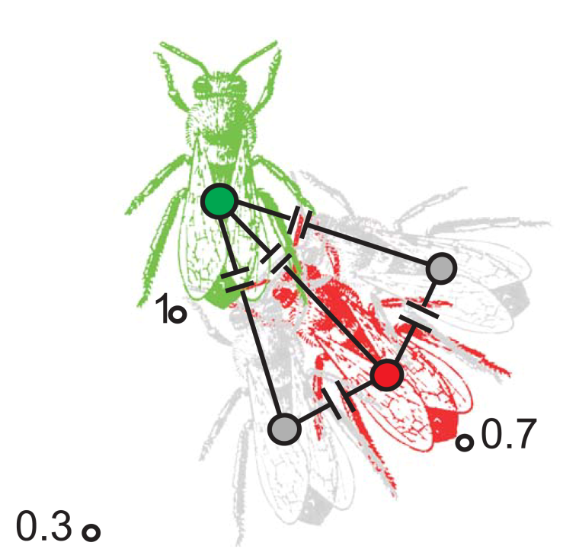
Reading the dance vectors recorded by an
electric ‘camera’ with 32 pixels (electrodes)
o
Reading the dance vector 330 1440 m transformed according to the time course of the day for the sun
Single fanning bee
as a point source
The signal strength drops to ~ 25%
according to Coulomb’ laws over
a distance of one cm
24 abdomen pulses
coding 24 x 60m
Capacitive coupling between dancer and 3 followers
as a consequence of the bee’s haemolymph (permittivity ~ 80)
o
330

Slide 12
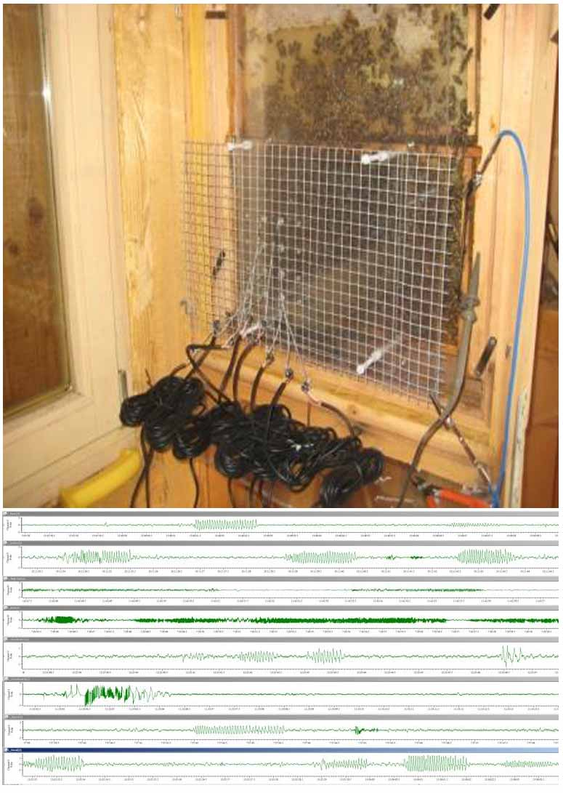
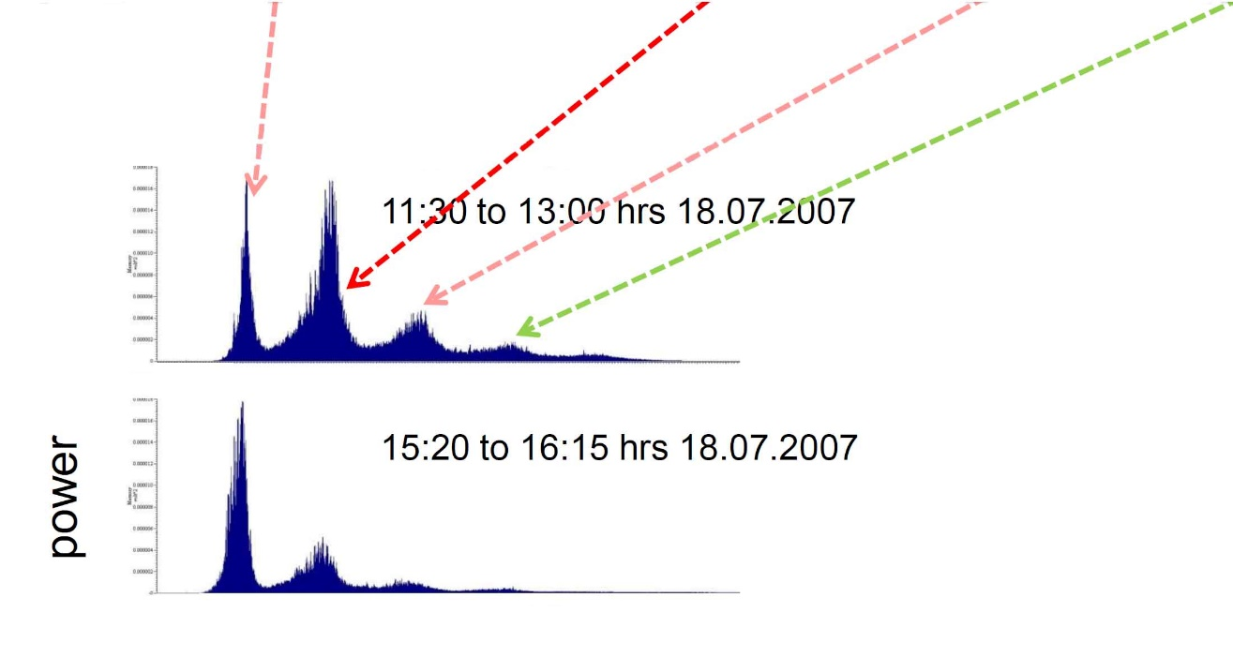
Fingerprints of activities on the comb
waggling fanning whirring stop tones
16 120 230 300
16 120 230 300
frequency[Hz]

Slide 13
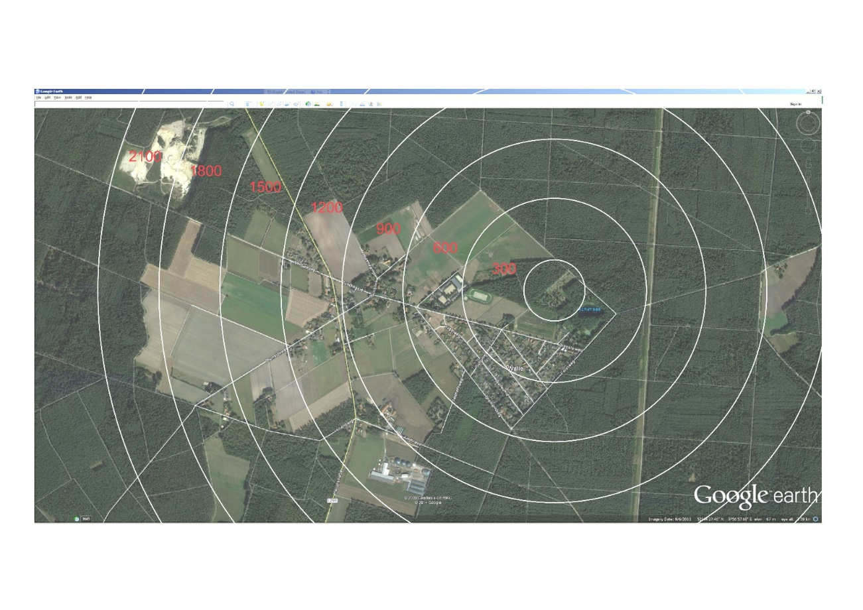
Environmental monitoring evaluated by bees
Frequency of waggle runs
Blossoming fruit trees
So, how can put these finding to practical use?
Distance in the dance [m]

Slide 14
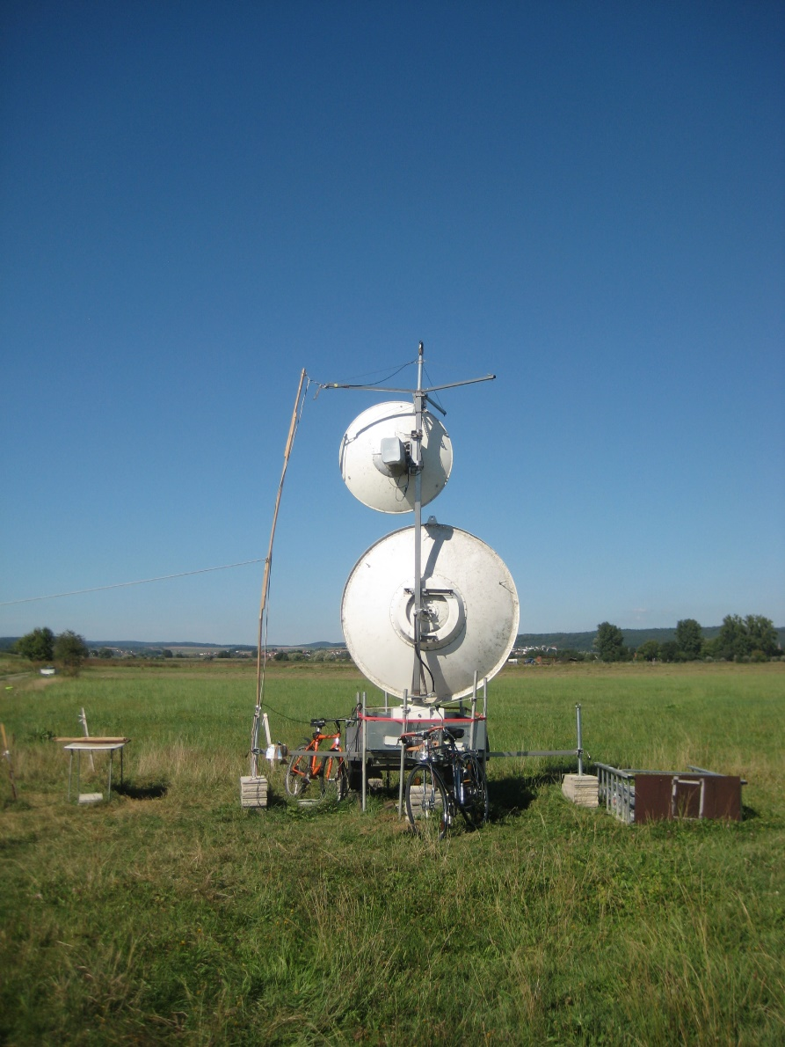
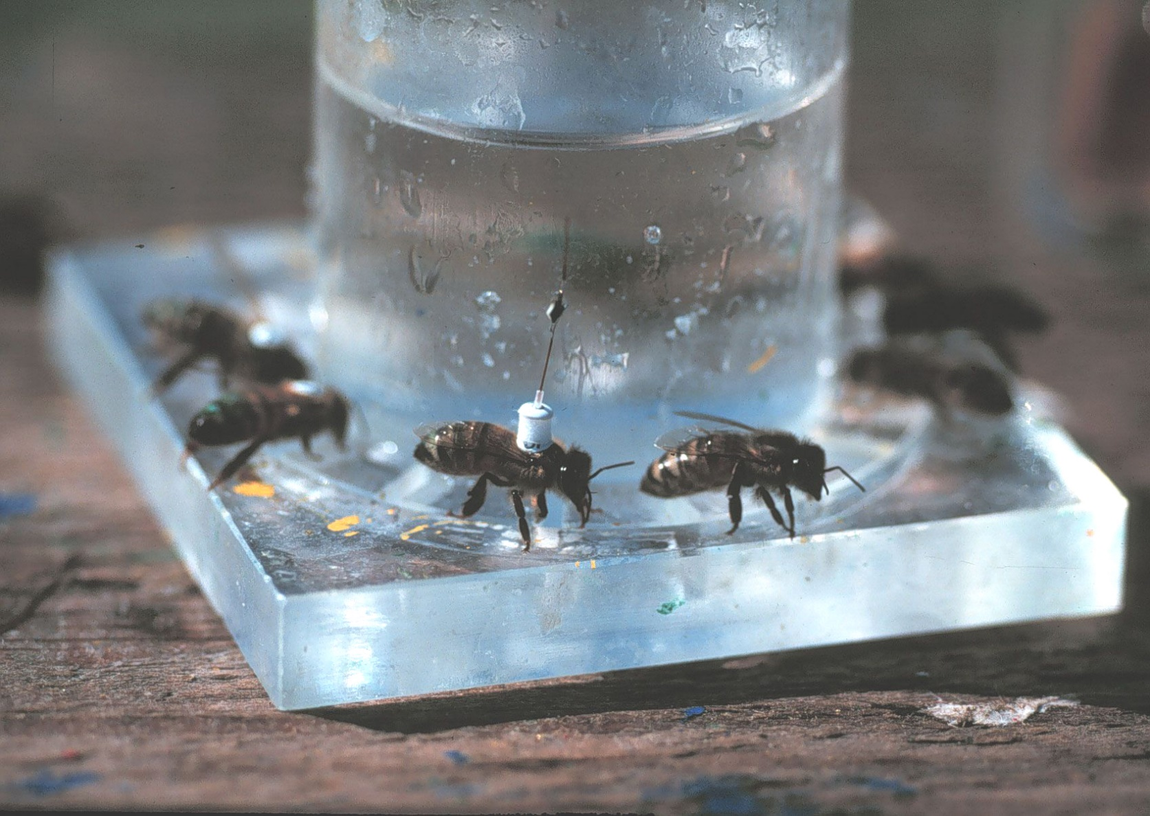
The interpretation of this environmental monitoring can be extended by a study of the bee’s cognitive map.
Harmonic radar tracking Bee with transponder at a feeder
Large antenna dish 9 Ghz 25kW small 18Ghz 11mm dipole, RF-diode (nonlinear)

Slide 15
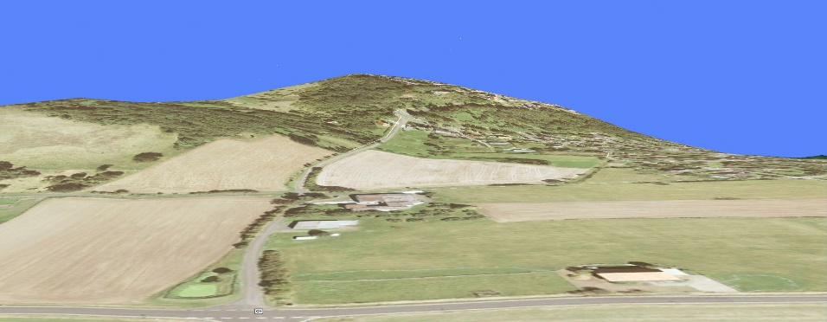
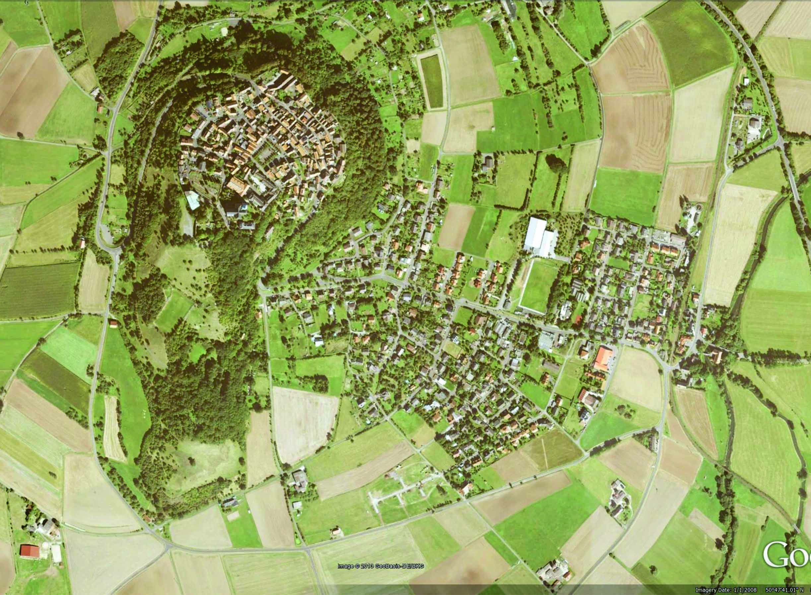
Features of the cognitive map in bees
100 m below the hilltop
Home area
Hive near a hill, located 575 m
from the market square on
the hilltop
----575– m------

Slide 16
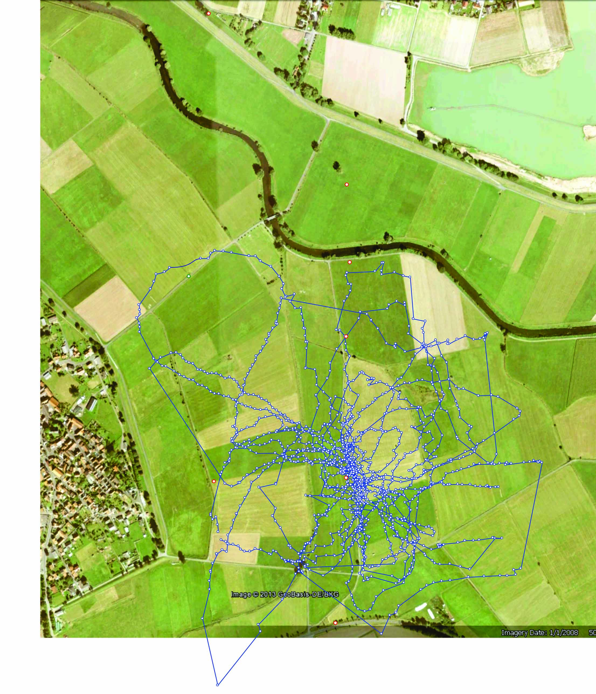
Bee lost in a completely unknown environment searching for its hive for about 2 hours.
First example:
Test field
Flat grassland with harmonic radar setup.
Harmonic radar
Release site

Slide 17
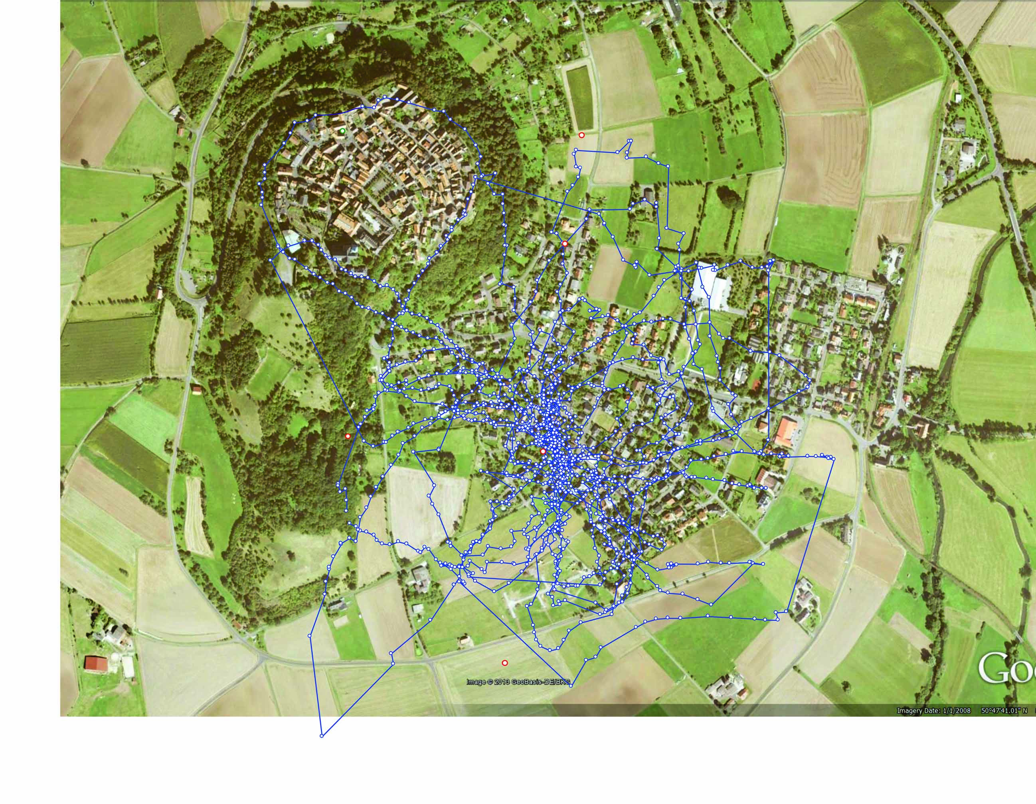
A trick: the recorded flight track is superimposed onto a google map of the home area

Slide 18
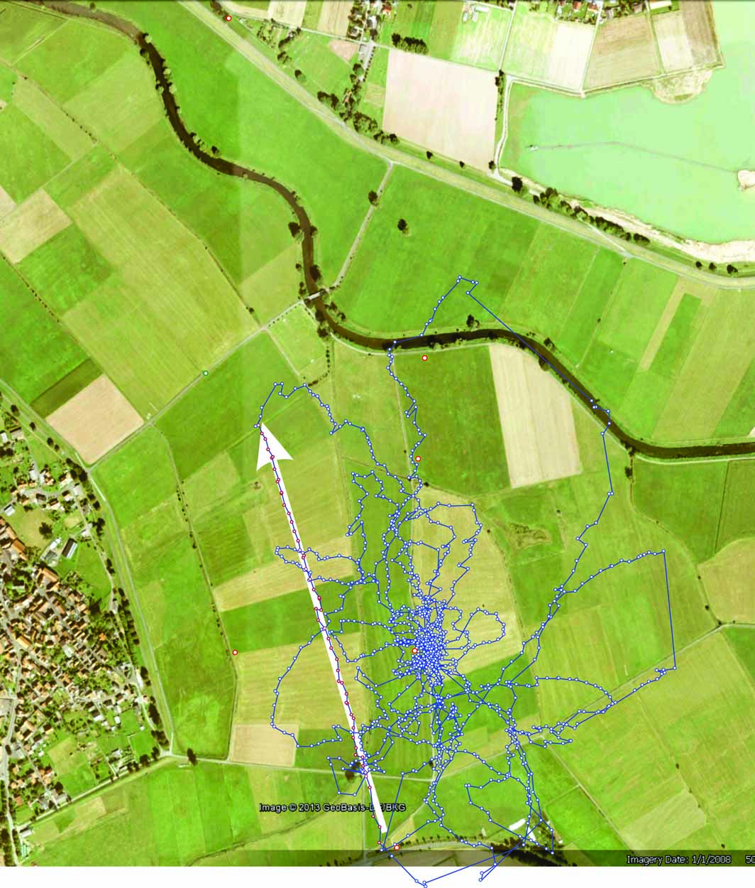
Bee lost in a completely unknown environment searching for its hive for about 2 hours.
second example:
Test field
Flat grassland with harmonic radar setup.
Harmonic radar
Release site
Surfaced road

Slide 19
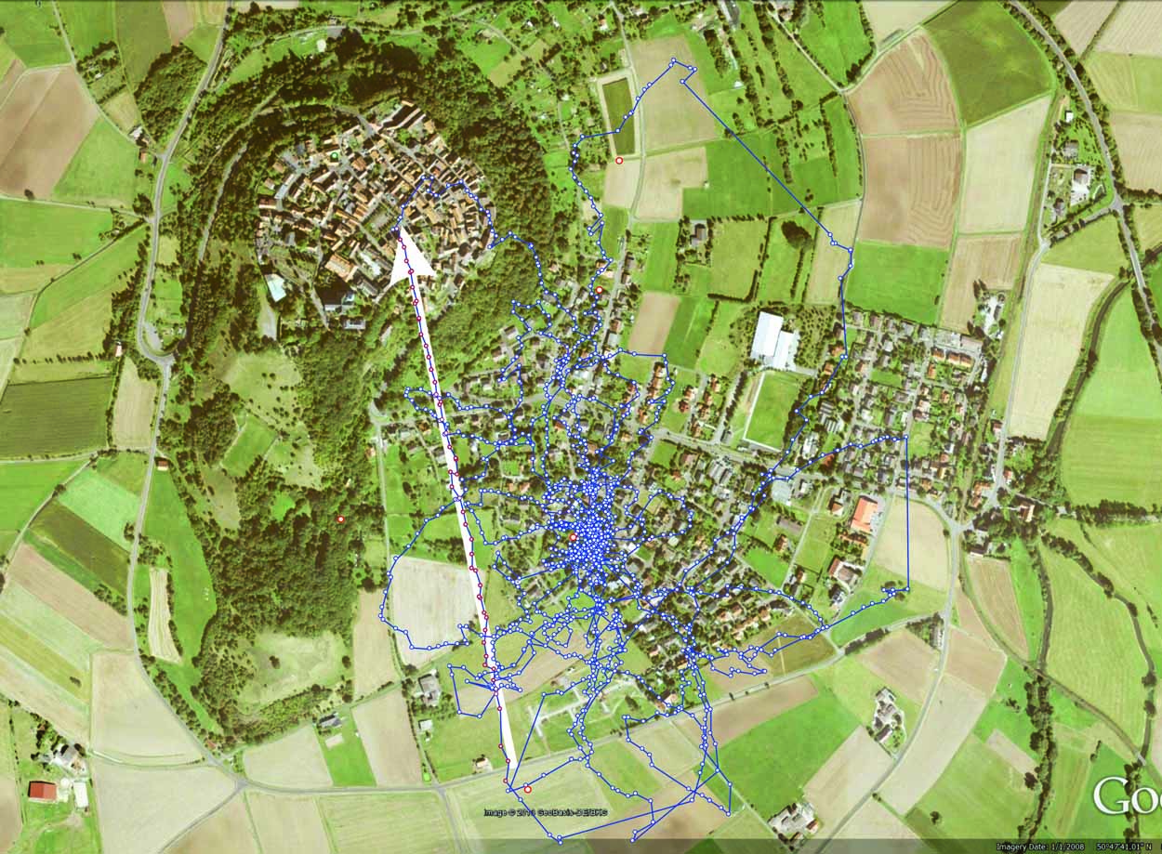
A trick: the recorded flight track is superimposed onto a google map of the home area
Surfaced road

Slide 20
Thank you!
The work presented here is a project of the research group led by Randolf Menzel at the FU Berlin, Germany.

Slide 22
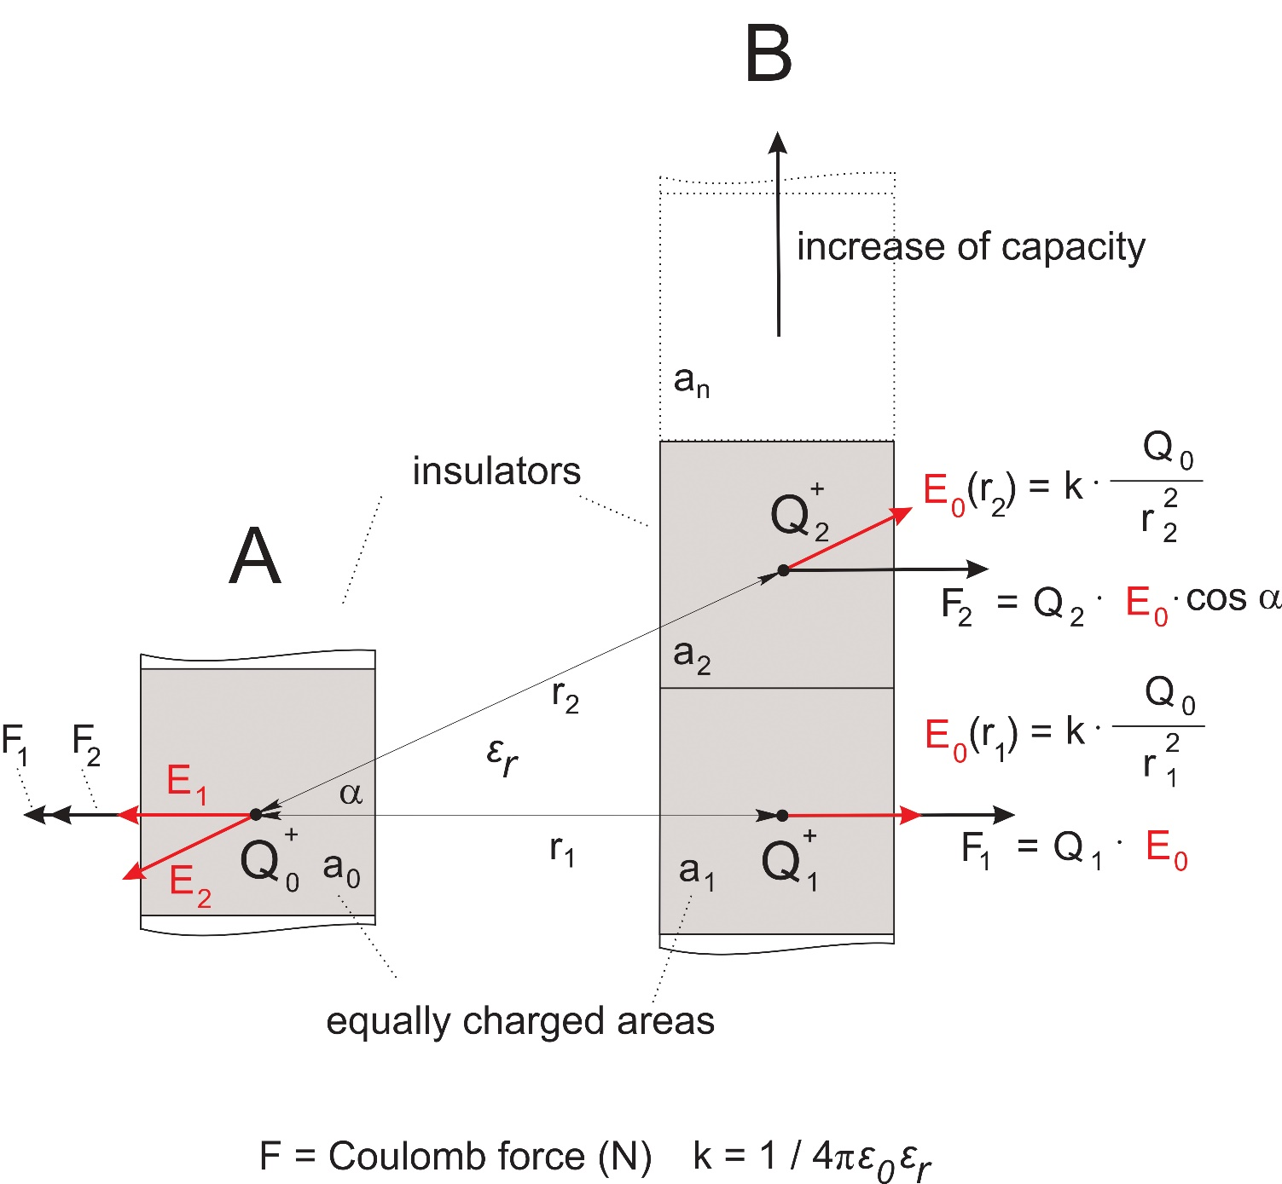

Slide 24
Capacitive coupling

Slide 25
